Slide 1
salaryball
Baseball player valuations have changed
Are their salaries following suit?

Slide 2
Alex’s Background

Slide 3
Anthony’s Background

Slide 4
Project Background
In the early 2000’s the Oakland A’s took a very different approach to determining a players value. They decided to use advanced analytics to find players that were currently undervalued in the market to fill their roster. They found players based on an analysis that identified the specific statistics that aligned mostly with wins. The Oakland A’s broke the single season winning record that year. And baseball player valuations have never been the same in Major League Baseball. Now 20 seasons later, analytics are still being used in a variety of ways. This project was a deep dive into the analytics of baseball using both traditional statistics and modern formulas, to examine how the advanced analytic era of player valuations might have changed the way that teams approach player salaries over time. Whether you love baseball, are a casual fan or are new to the sport, this presentation will provide some unique insights into the game through the lens of data science and the way teams strategize their payrolls to win games in the era of advanced analytics.

Slide 5
Methods
Used data from 2 main sources:
Lahman’s Baseball Database & Baseball Reference’s WAR data
Lahman’s Database
Compiled by Sean Lahman, an award-winning reporter & sports statistician
The preeminent data source for baseball analysis
Consists of 24 different datasets on various baseball-related topics
We used: Batting, Pitching, Fielding, Salaries, People, & Teams

Slide 6
Methods
Datasets contained over 100,000 entries
Each entry represents one player’s performance for one season
Salary data only for 1985-2016
Subset data to create two different data frames for 1995-1999 & 2015-2019
Pre-sabermetric revolution and post-sabermetric revolution
BattingA: 6,363 entries
BattingB: 7,566 entries
PitchingA: 3,070 entries
PitchingB: 4,294 entries

Slide 7
Methods
Important Variables:
HR (BattingA): Min. 1st Qu. Median Mean 3rd Qu. Max.
0.000 2.000 5.000 9.279 13.000 70.000
HR (BattingB): Min. 1st Qu. Median Mean 3rd Qu. Max.
0.00 2.00 7.00 10.36 15.00 59.00
RBI (BattingA): Min. 1st Qu. Median Mean 3rd Qu. Max.
0.00 4.00 17.00 30.05 46.00 165.00
RBI (BattingB): Min. 1st Qu. Median Mean 3rd Qu. Max.
0.00 4.00 18.00 28.97 48.00 133.00
Salary (Salaries): Min. 1st Qu. Median Mean 3rd Qu. Max.
0 294702 550000 2085634 2350000 33000000

Slide 8
Methods
SO (PitchingA): Min. 1st Qu. Median Mean 3rd Qu. Max.
0.00 11.00 33.50 48.10 68.75 364.00
SO (PitchingB): Min. 1st Qu. Median Mean 3rd Qu. Max.
0.00 9.00 30.00 46.71 66.00 326.00
ERA (PitchingA): Min. 1st Qu. Median Mean 3rd Qu. Max.
0.000 3.660 4.760 5.768 6.260 162.000
ERA (PitchingB): Min. 1st Qu. Median Mean 3rd Qu. Max.
0.000 3.240 4.390 5.557 6.000 162.000
W (PitchingA): Min. 1st Qu. Median Mean 3rd Qu. Max.
0.000 0.000 2.000 3.715 5.000 24.000
W (PitchingB): Min. 1st Qu. Median Mean 3rd Qu. Max.
0.000 0.000 1.000 2.829 4.000 22.000

Slide 9
Methods
Baseball Reference Batting/Pitching WAR datasets
Compiled by Baseball Reference, an online encyclopedia which provides detailed statistics throughout the history of organized baseball
Consists of 2 separate datasets, one for batting metrics, one for pitching metrics
Contains new, advanced metrics such as Wins Above Replacement, OPS+, ERA+

Slide 10
Methods
Datasets contained over 100,000 entries
Each entry represents one player’s performance for one season
Subset data to create two different data frames for 1995-1999 & 2015-2019
warBatA, warBatB, warPitchA, & warPitchB
warBatA: 6,357 entries
warBatB: 7,253 entries
warPitchA: 3,067 entries
warPitchB: 4,293 entries

Slide 11
Methods
Important Variables:
Salary (warBatA): Min. 1st Qu. Median Mean 3rd Qu. Max.
109000 175000 300000 1195534 1500000 14936667
Salary (warBatB): Min. 1st Qu. Median Mean 3rd Qu. Max.
100000 555000 1550000 4468661 6000000 42143000
Salary (warPitchA): Min. 1st Qu. Median Mean 3rd Qu. Max.
109000 170000 265000 1034818 1100000 11100000
Salary (warPitchB): Min. 1st Qu. Median Mean 3rd Qu. Max.
100000 555000 1350000 3932439 5000000 42143000

Slide 12
Methods
WAR (warBatA): Min. 1st Qu. Median Mean 3rd Qu. Max.
-3.2600 -0.0800 0.0000 0.5046 0.4800 9.8400
WAR (warBatB): Min. 1st Qu. Median Mean 3rd Qu. Max.
-2.7500 -0.0400 0.0000 0.4307 0.2800 10.8600
WAR (warPitchA): Min. 1st Qu. Median Mean 3rd Qu. Max.
-3.1700 -0.2300 0.1600 0.6284 1.1000 11.9300
WAR (warPitchB): Min. 1st Qu. Median Mean 3rd Qu. Max.
-2.2900 -0.1800 0.1000 0.4783 0.7800 10.4600

Slide 13
Methods
Age (warBatA): Min. 1st Qu. Median Mean 3rd Qu. Max.
19.0 25.0 28.0 28.2 31.0 44.0
Age (warBatB): Min. 1st Qu. Median Mean 3rd Qu. Max.
19.00 25.00 27.00 27.99 30.00 45.00
Age (warPitchA): Min. 1st Qu. Median Mean 3rd Qu. Max.
19.00 25.00 27.00 28.05 31.00 44.00
Age (warPitchB): Min. 1st Qu. Median Mean 3rd Qu. Max.
19.00 25.00 27.00 28.03 30.00 45.00

Slide 14
Results

Slide 15
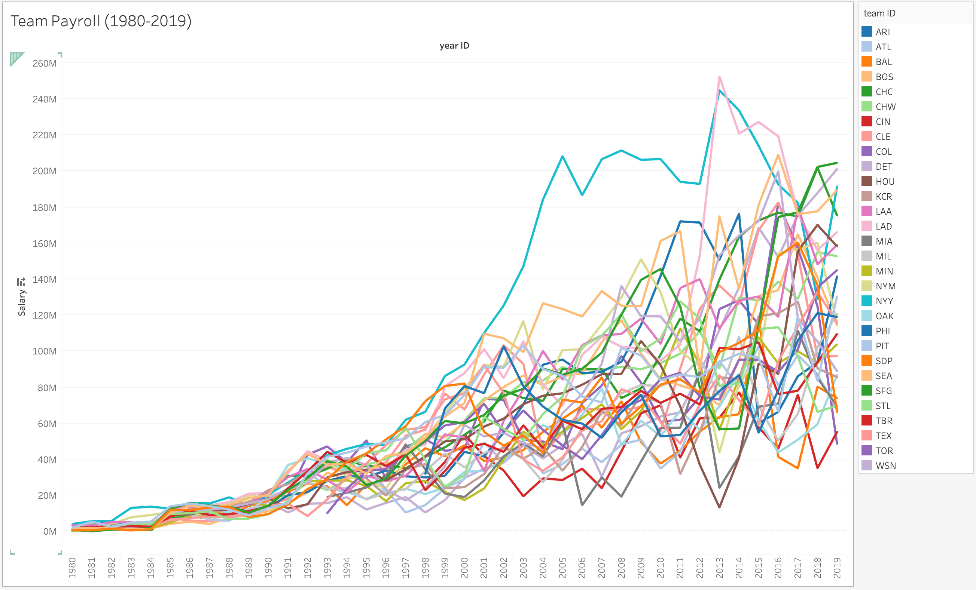

Slide 16
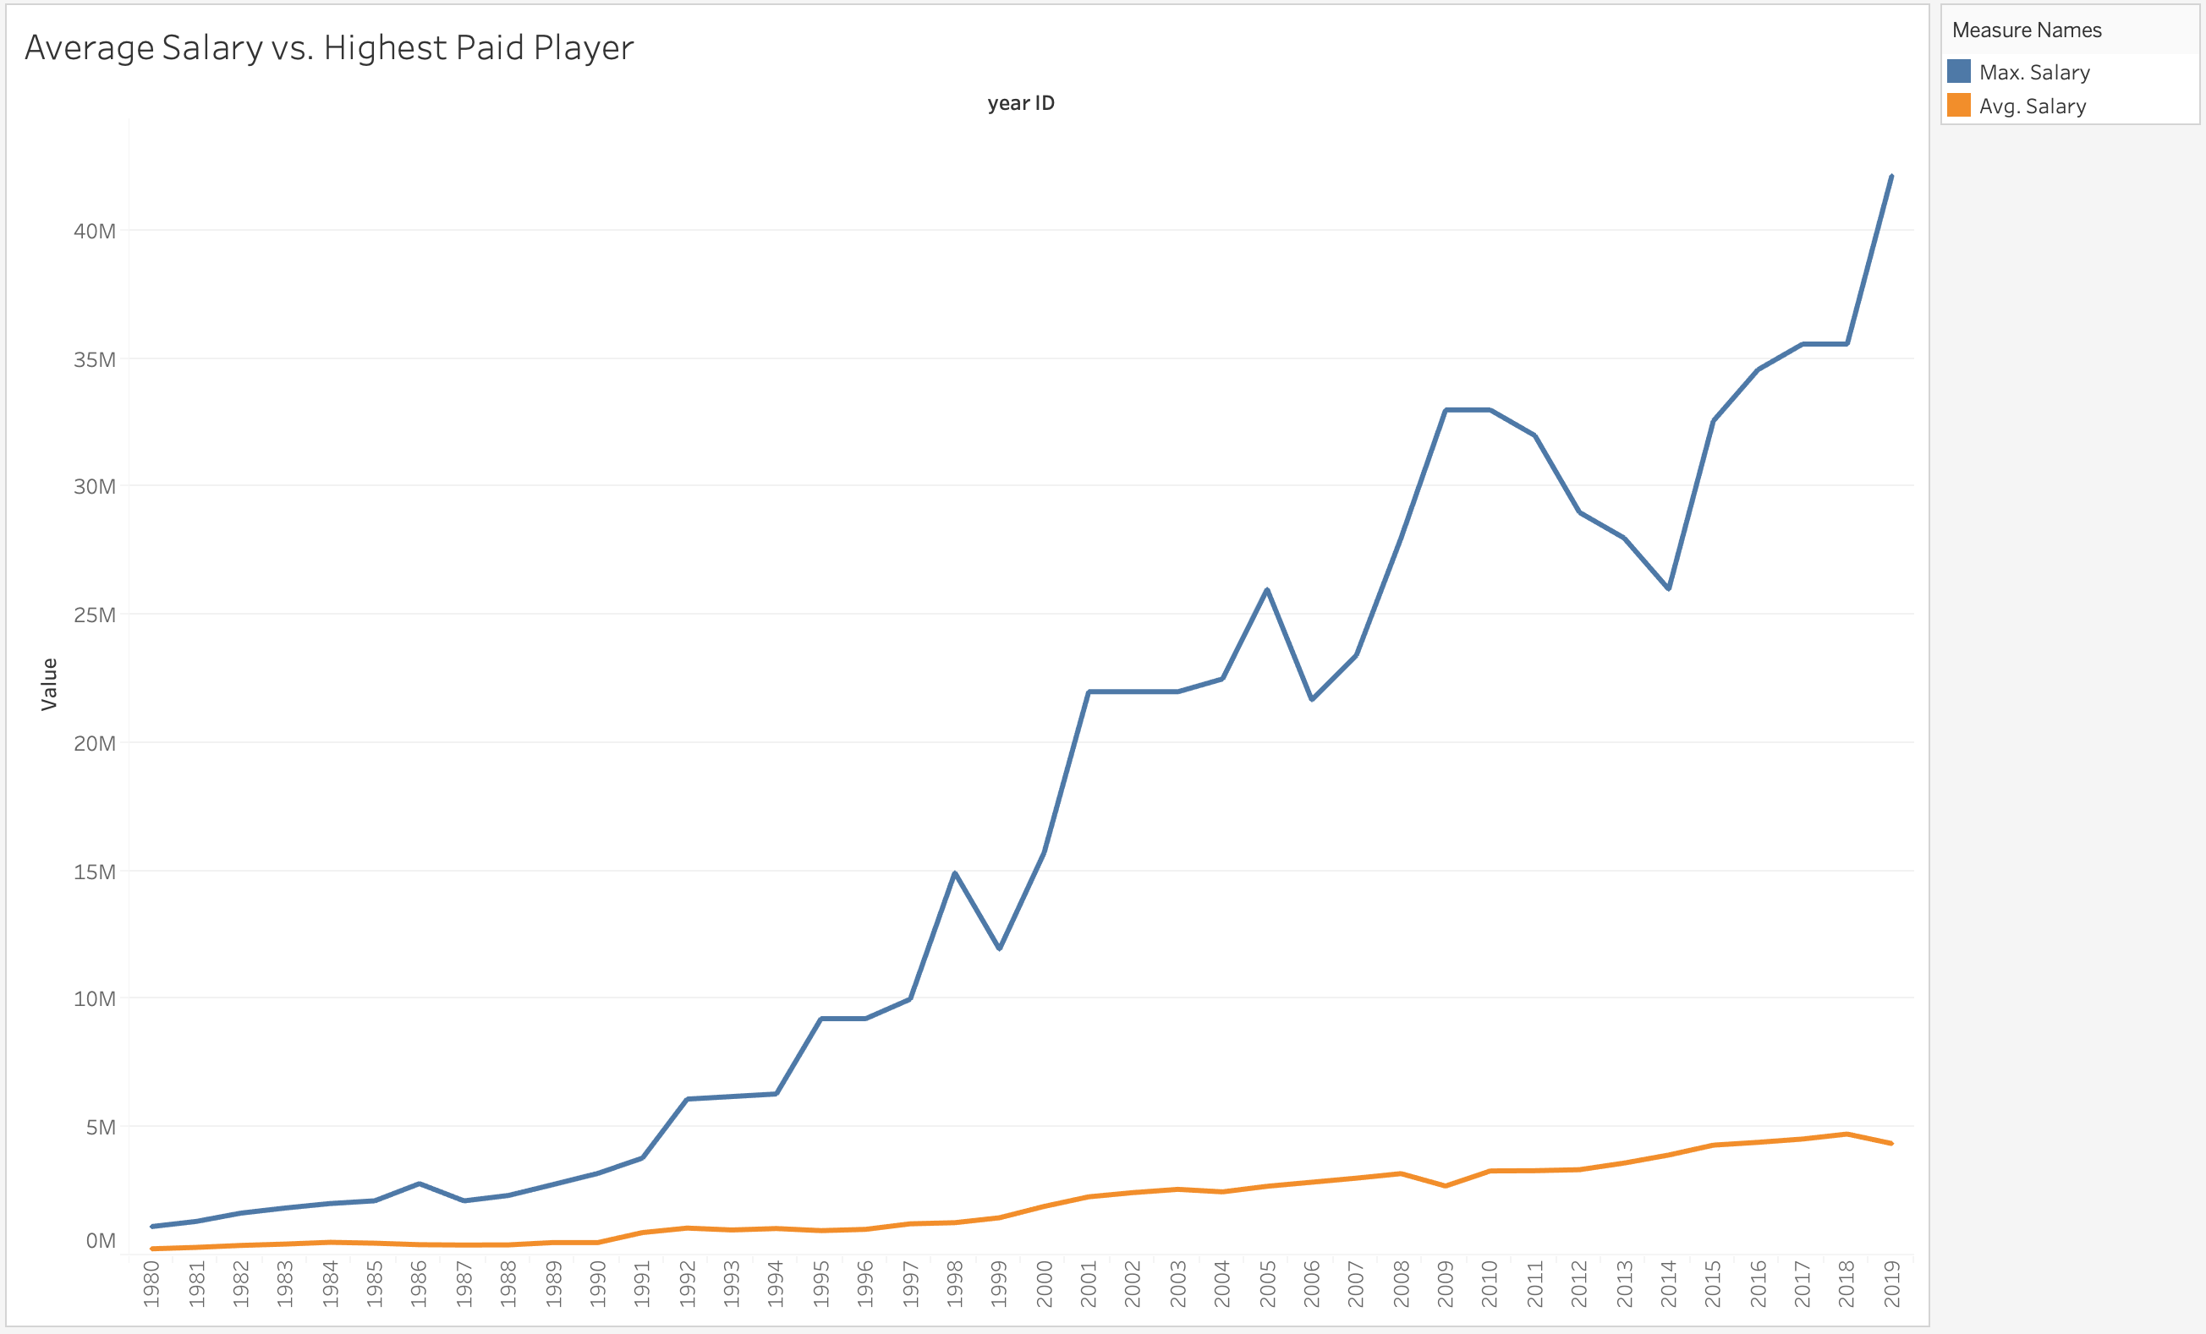

Slide 17
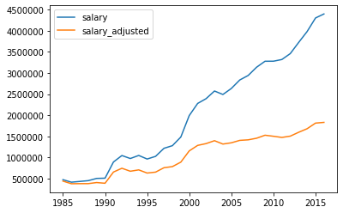
Average Salary vs. Inflation-Adjusted Average Salary

Slide 18
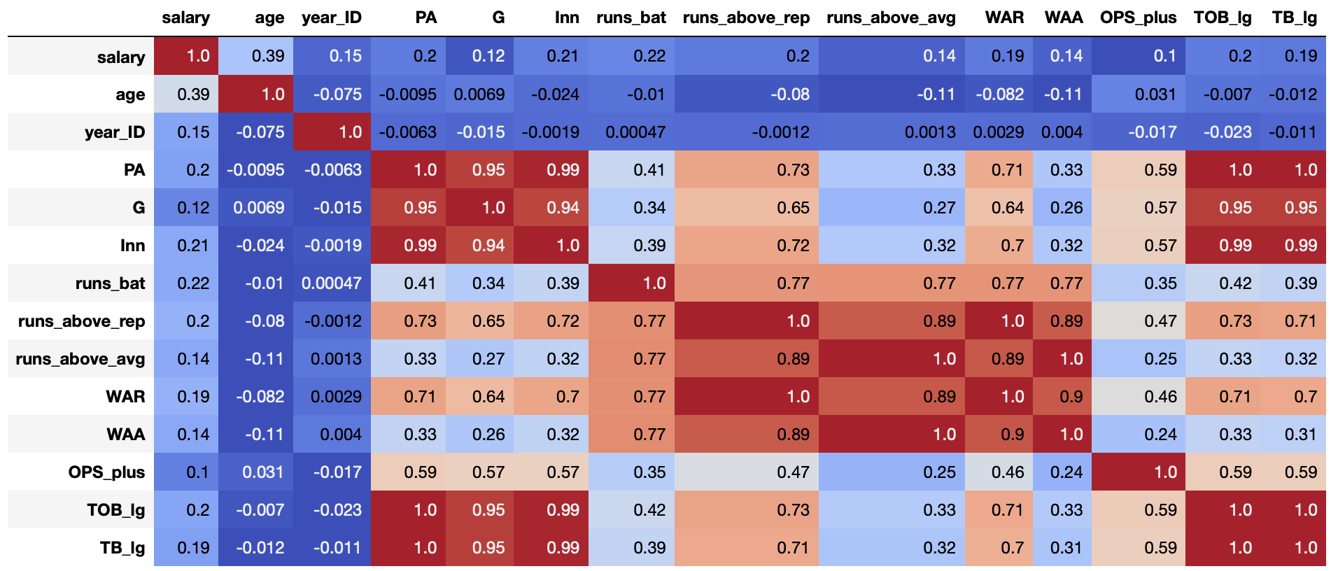

Slide 19
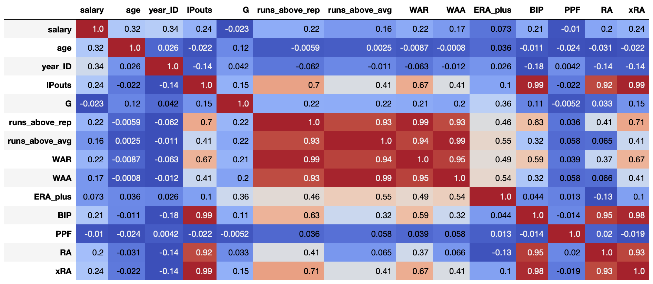

Slide 20
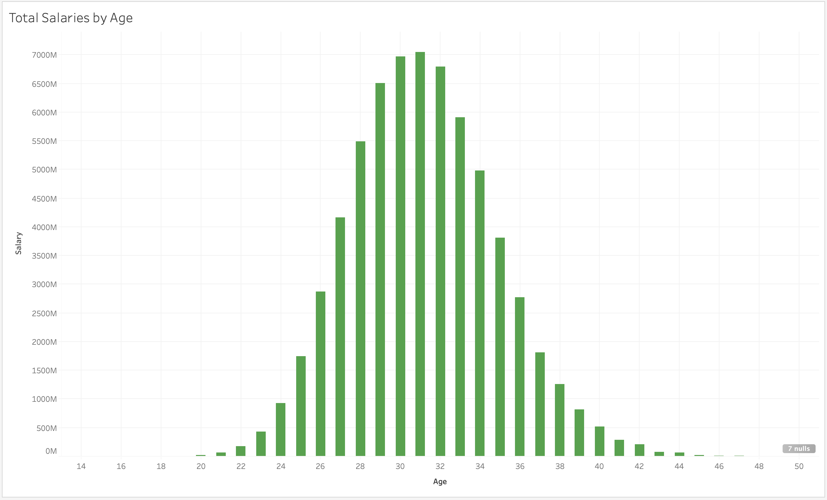

Slide 21
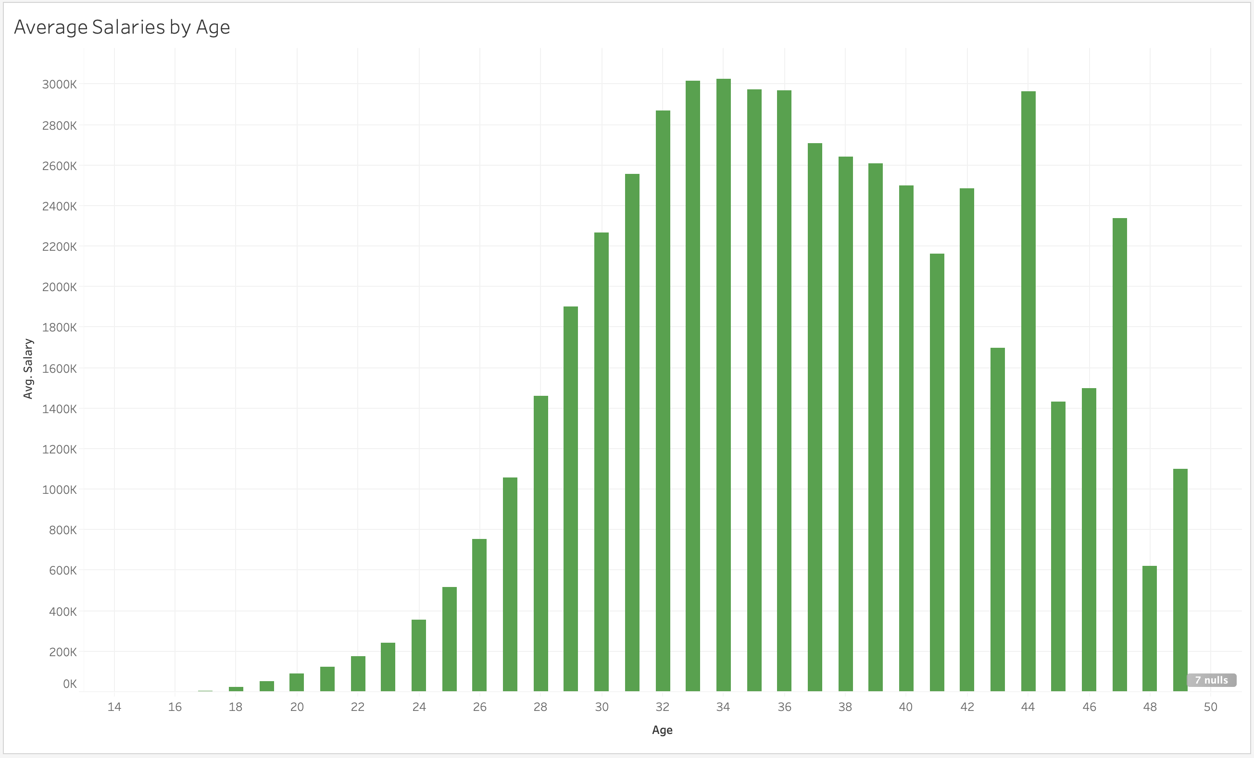

Slide 22
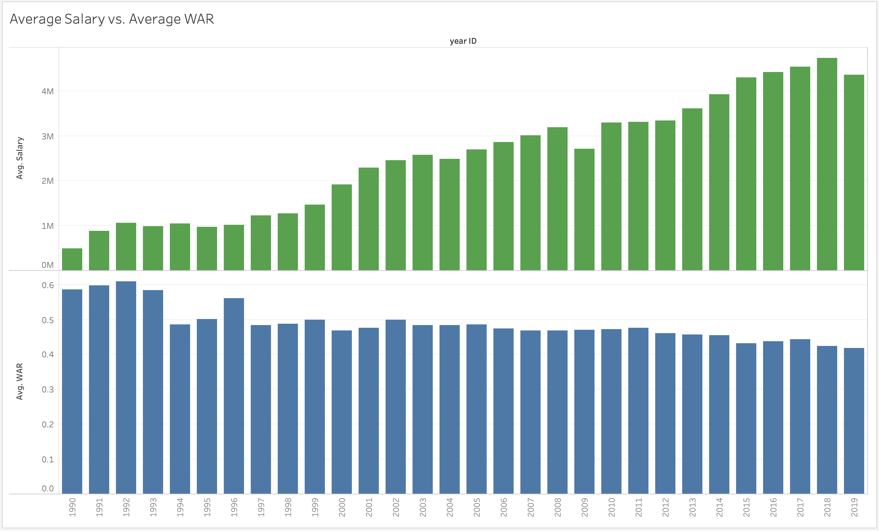

Slide 23
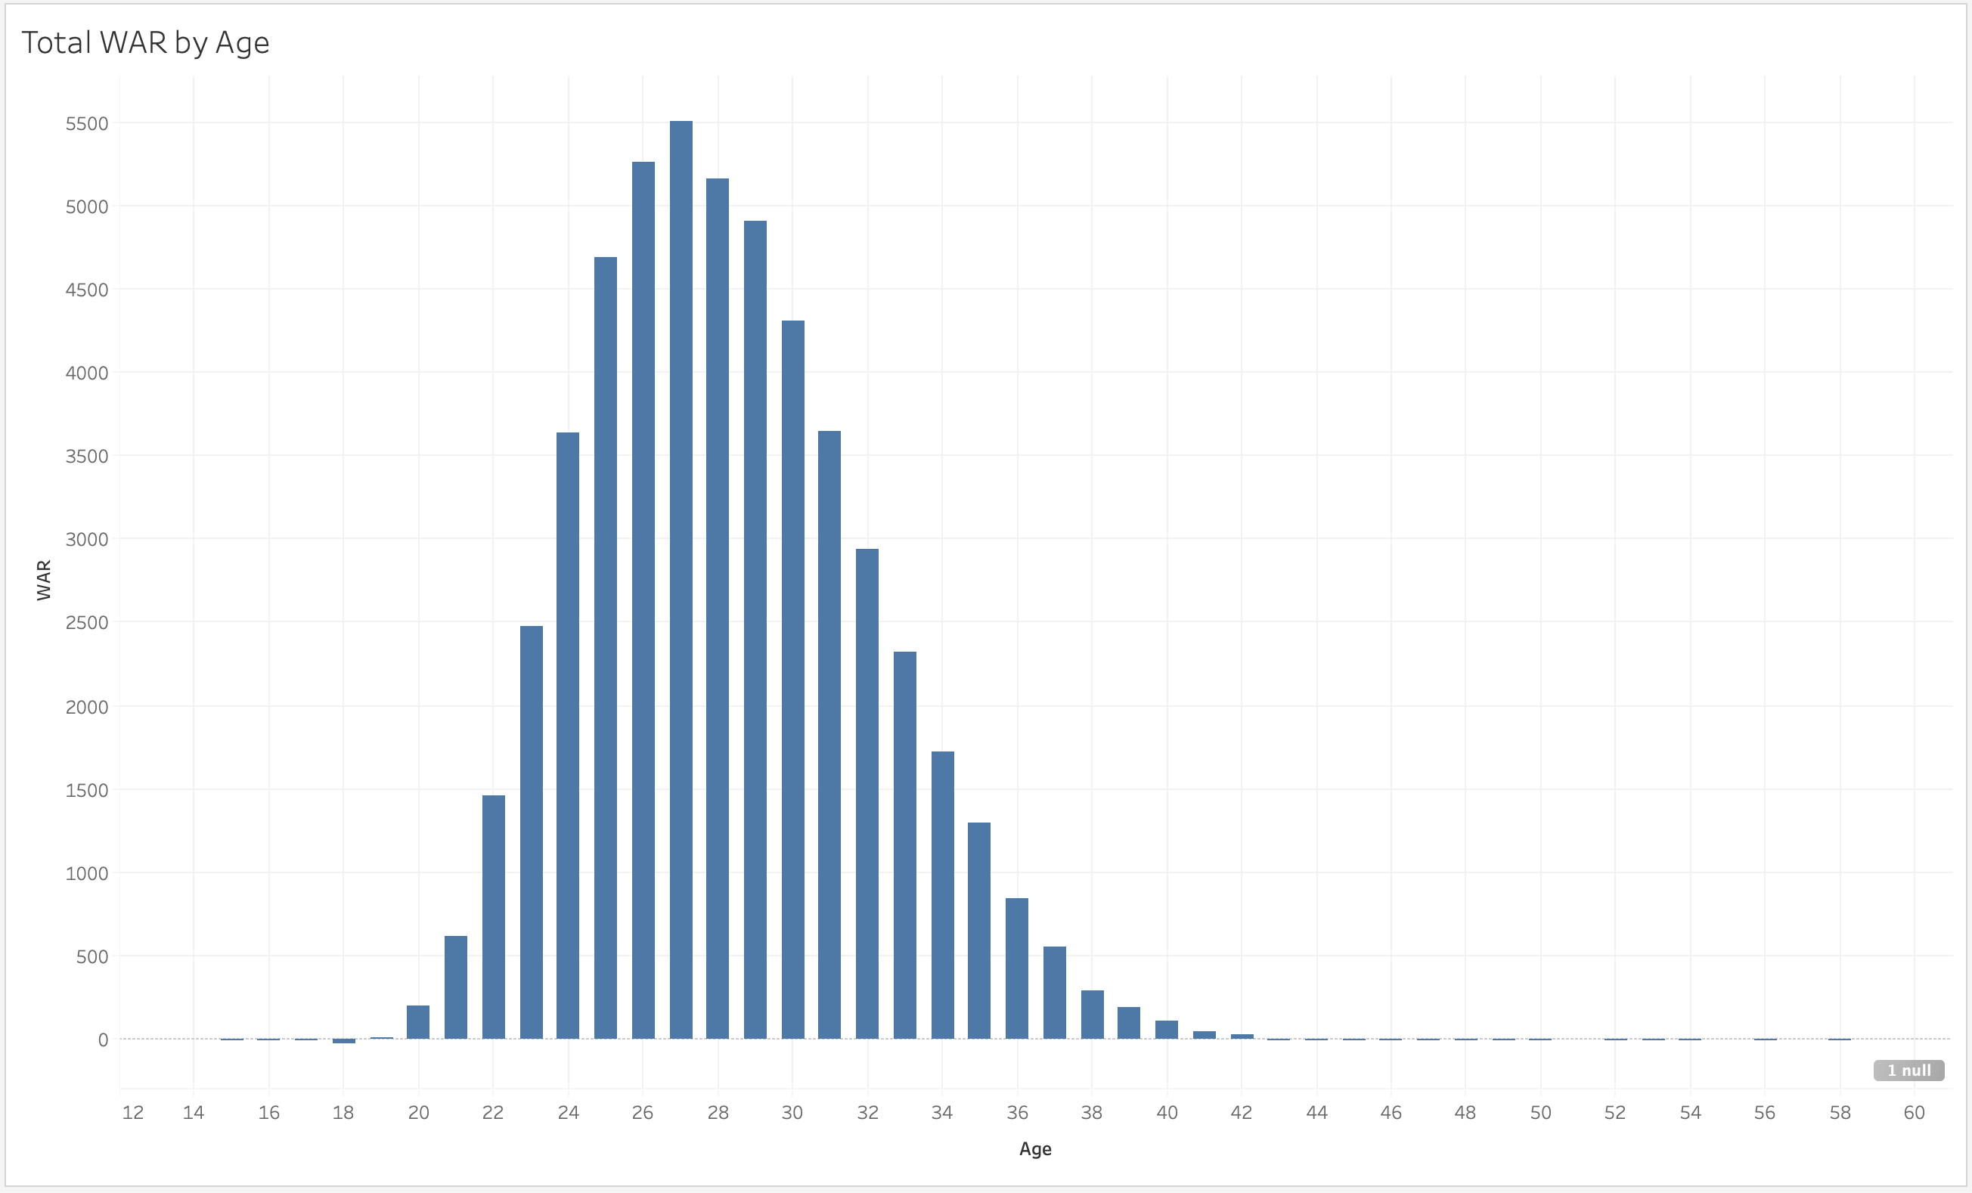

Slide 24
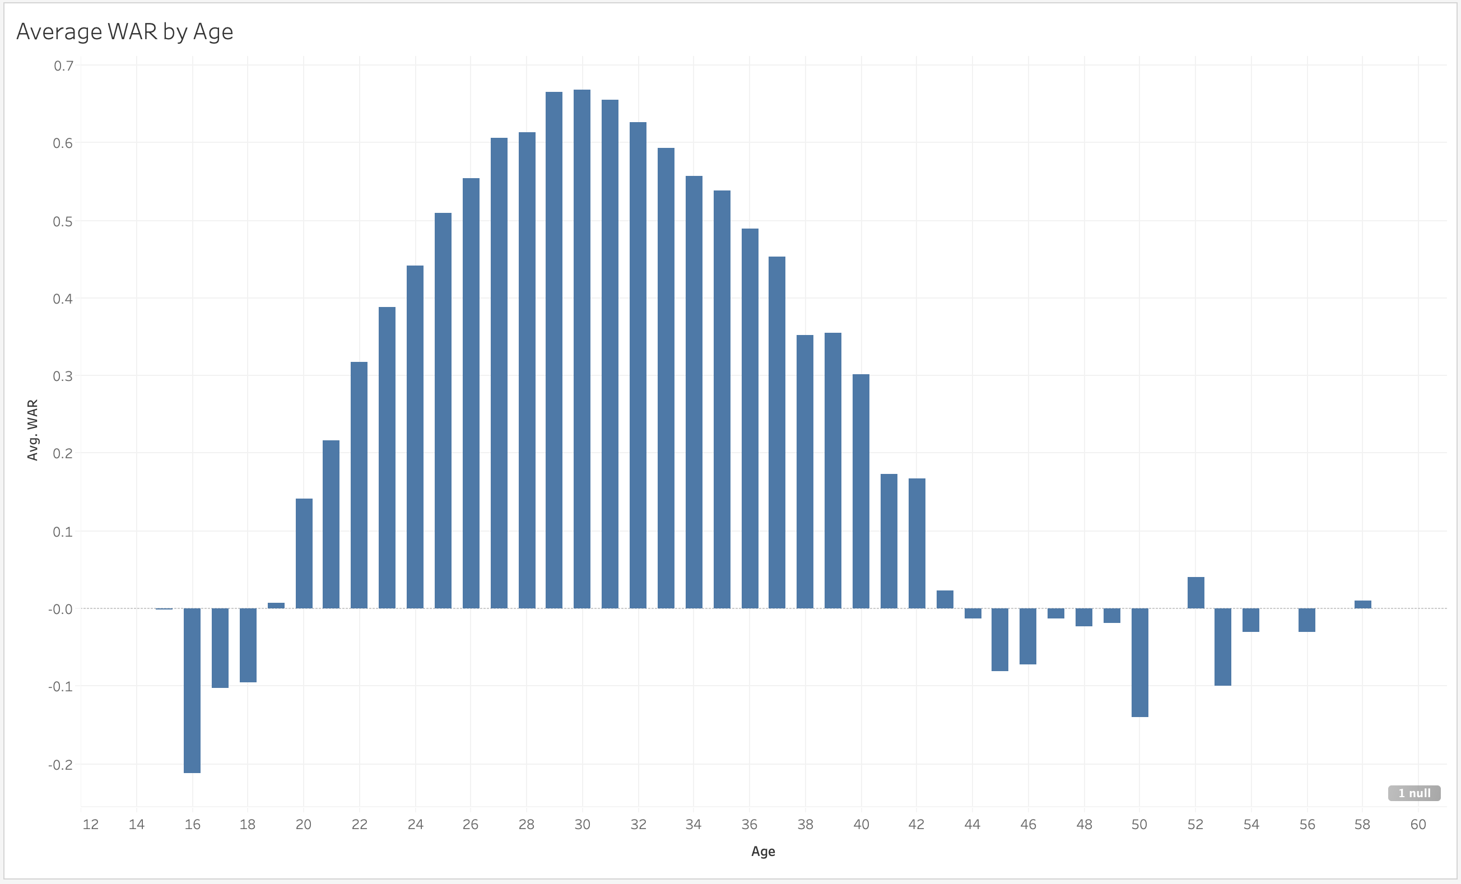

Slide 25
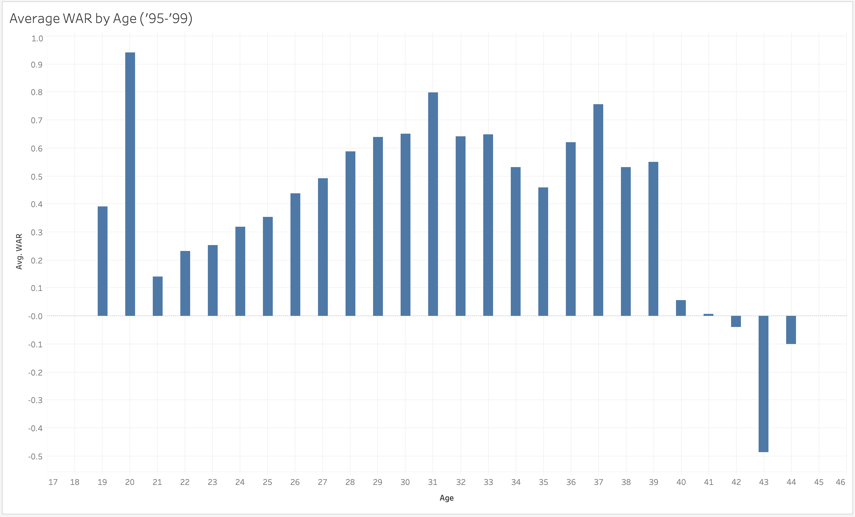

Slide 26
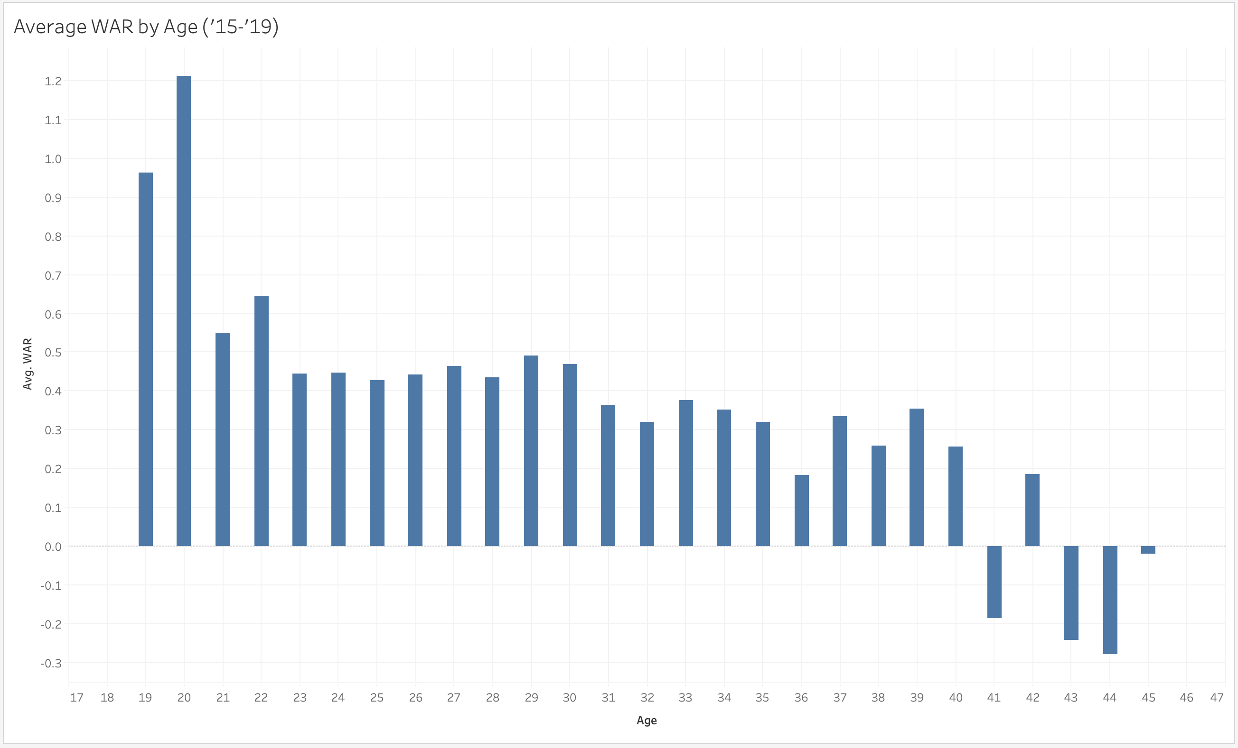

Slide 27
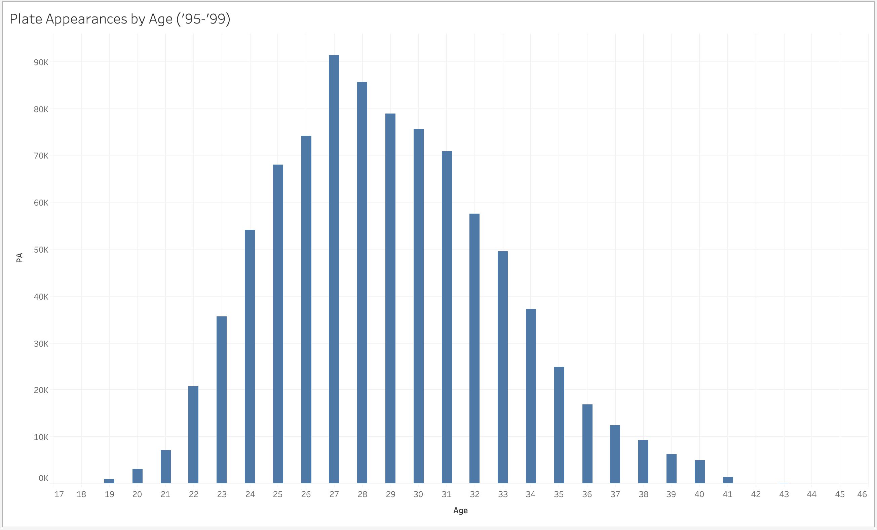

Slide 28
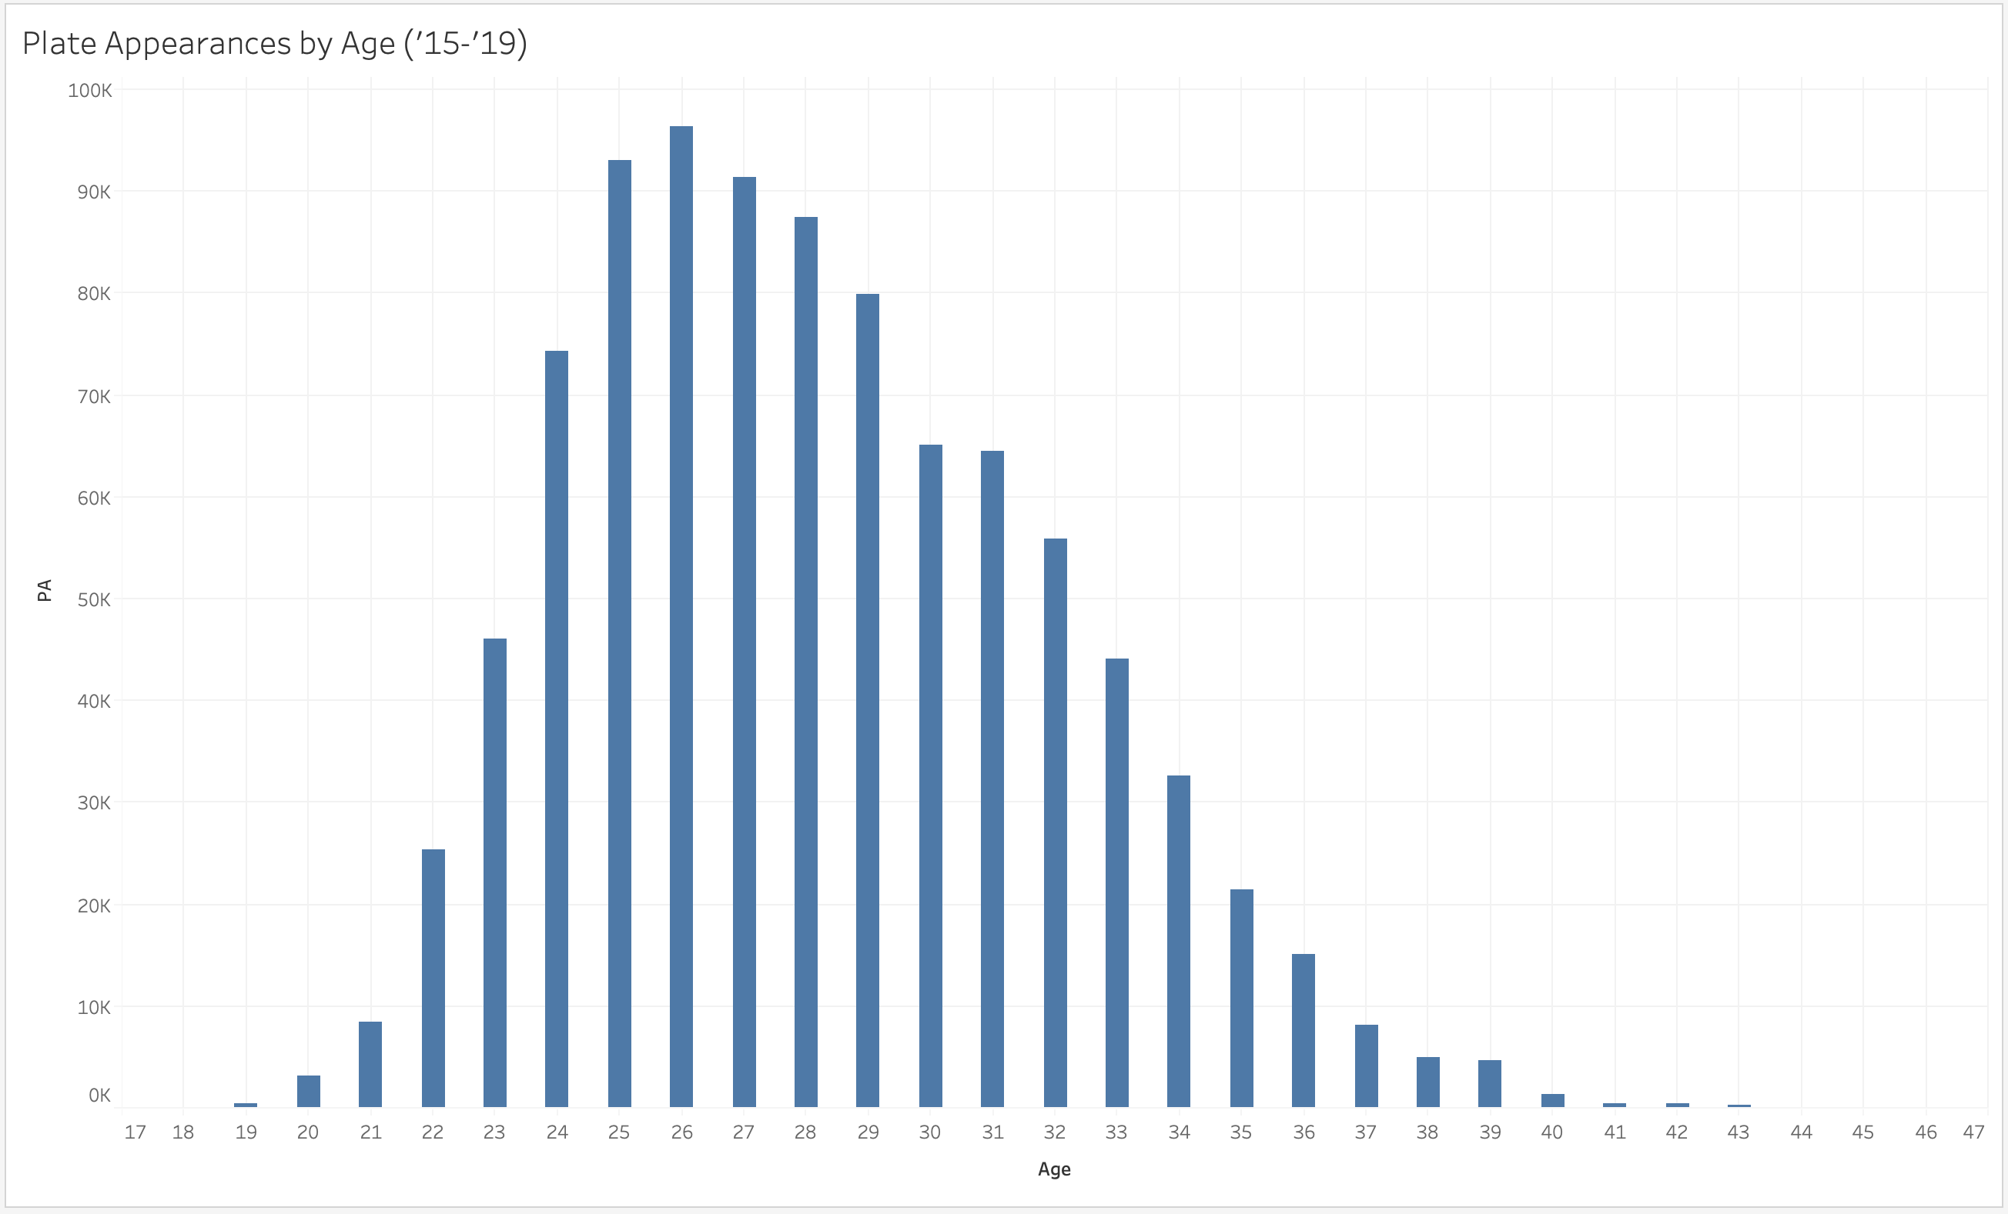

Slide 29
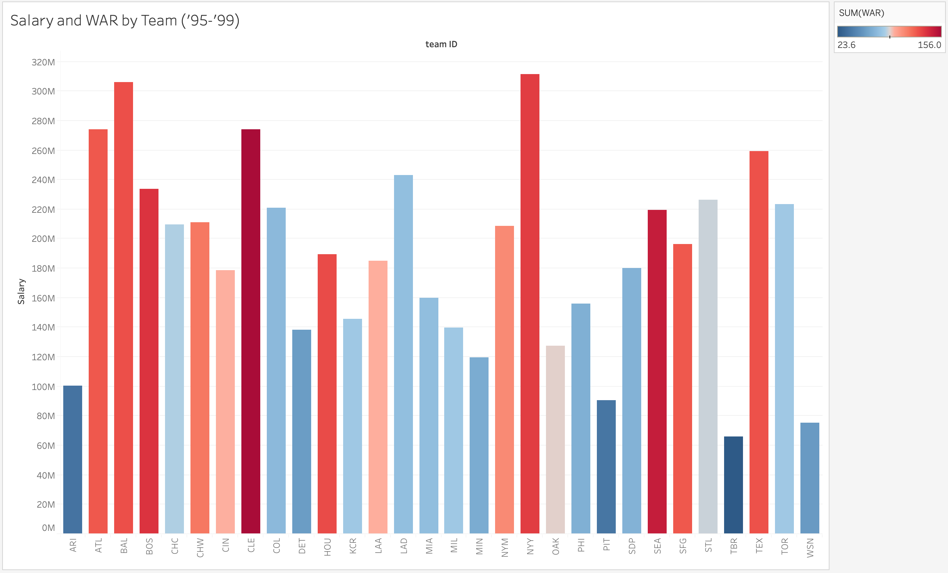

Slide 30
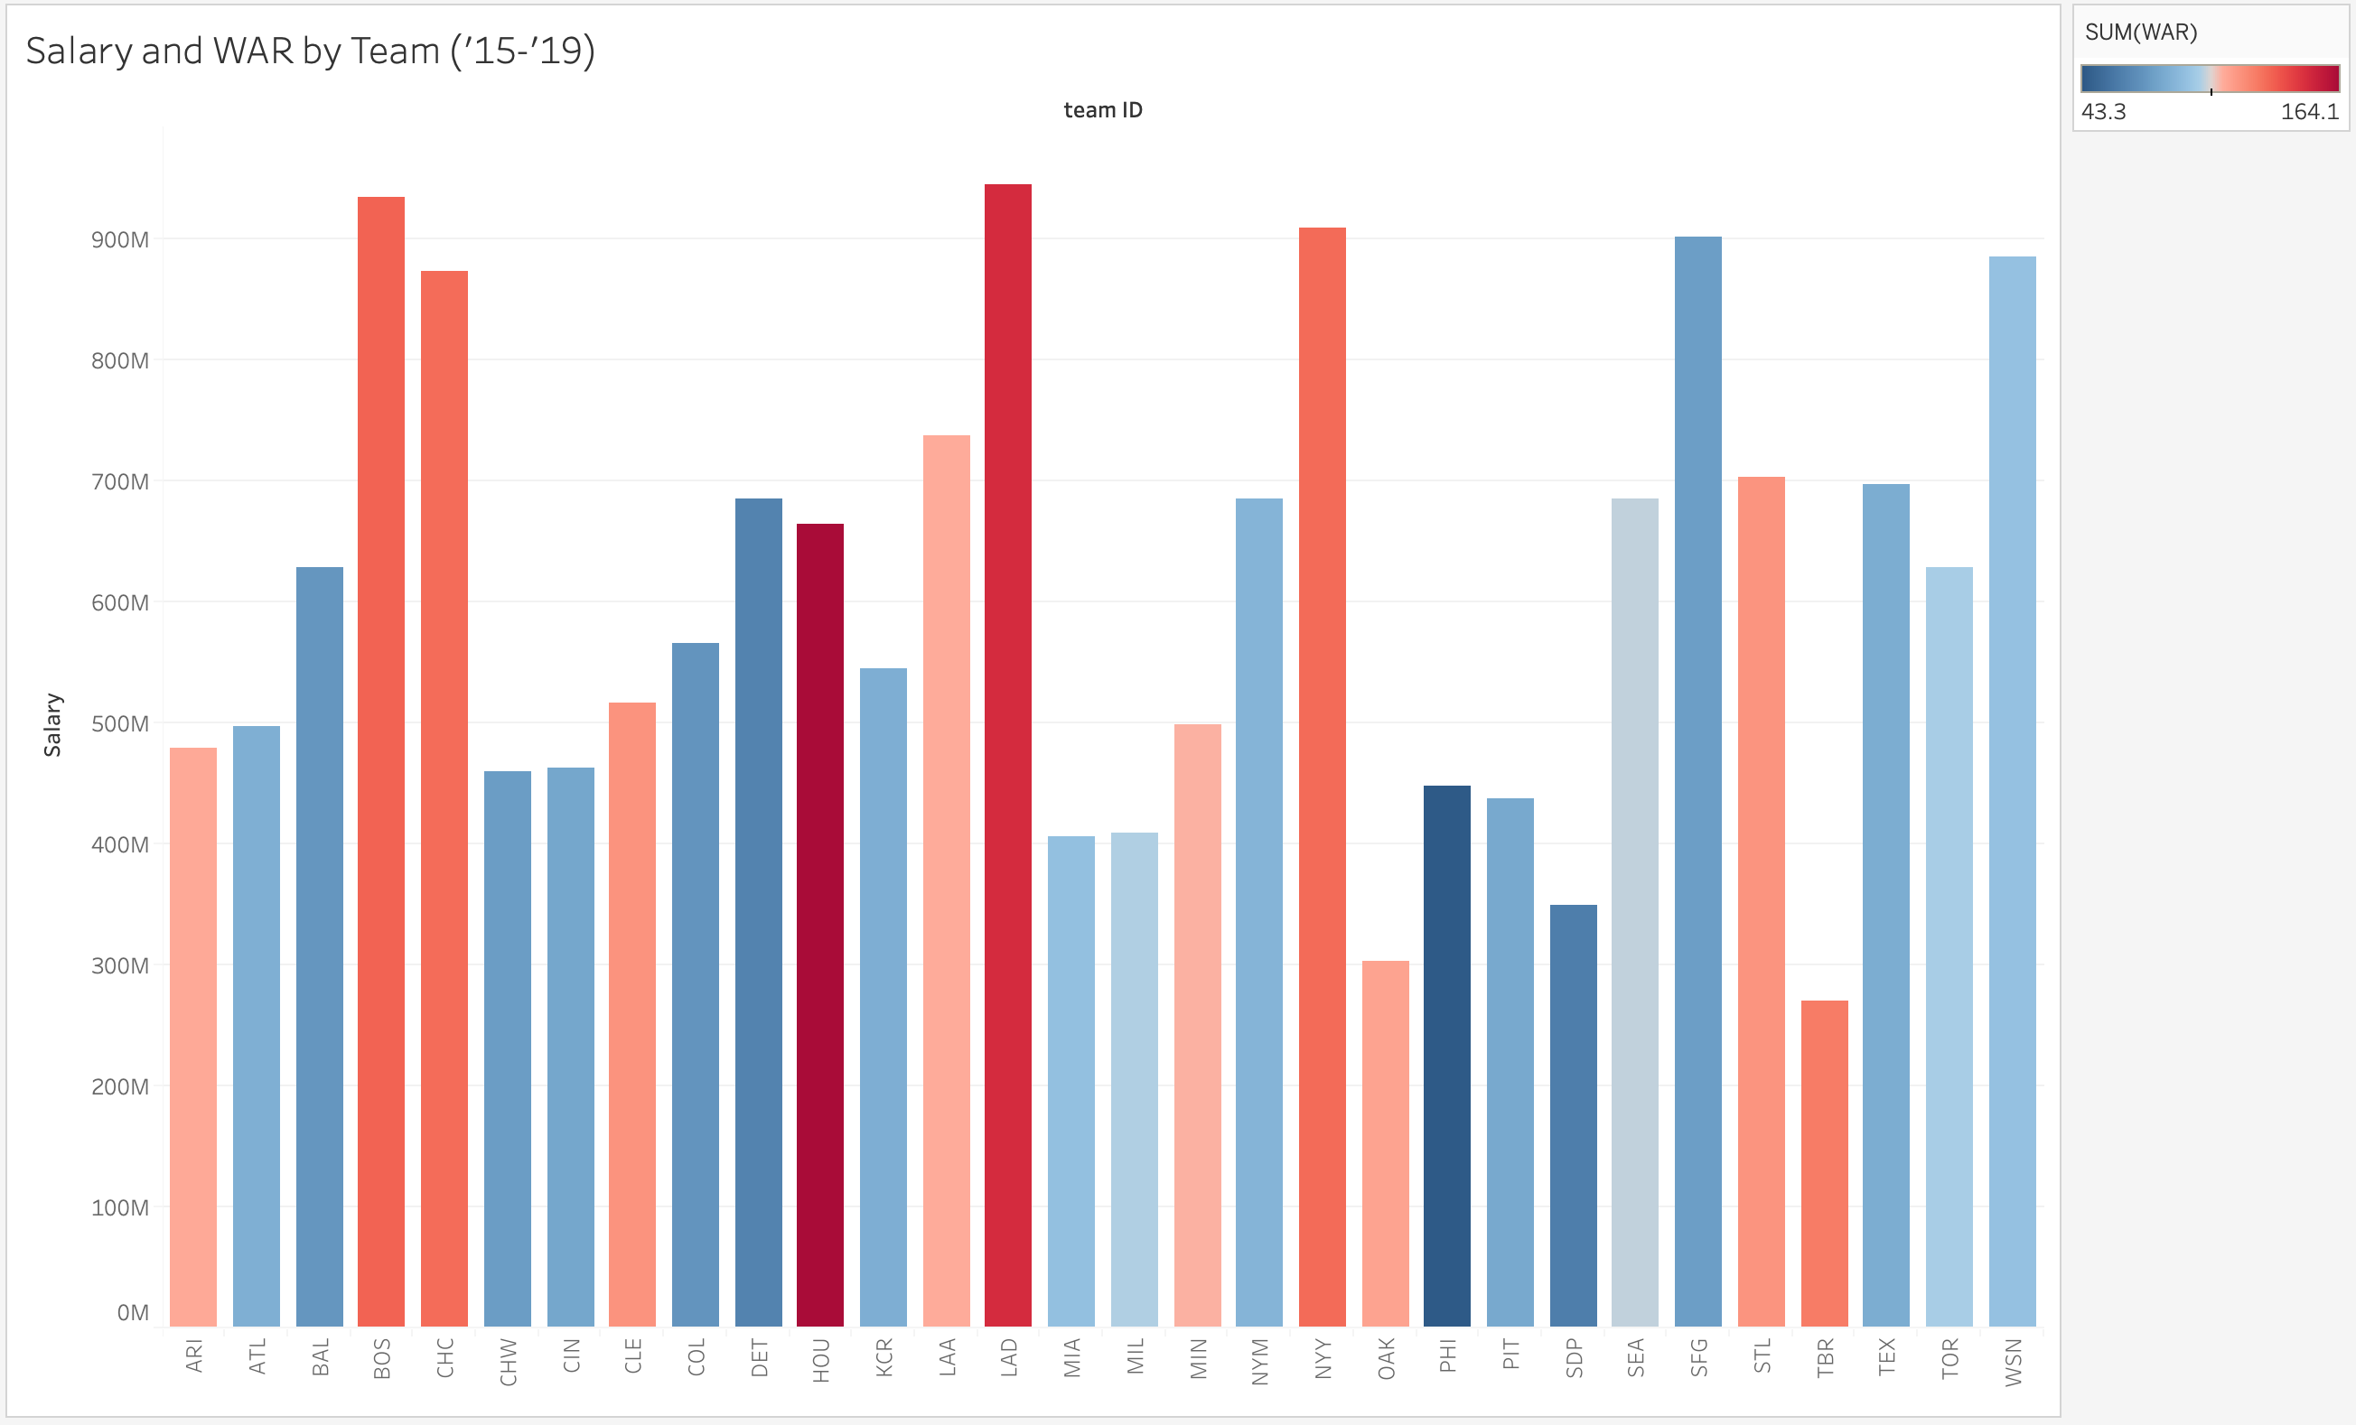

Slide 31
Summary

Slide 32
Conclusions

Slide 33
Thanks for your time Questions?

